Slide 1
Sheep Brain
Practice Exam #1

Slide 2
Name the following structures indicated by the arrows.
Click to the next slide to see the answer.
*For best results on these practice exams, write your answers on paper before clicking to see the correct answer. Try to answer within a minute (remember your lab exams will be timed) and make sure to check your spelling!
*note: not every structure you are required to know will be on this practice exercise so make sure you review the checklist of structures (p. 137 in your lab manual) when preparing for your lab exam

Slide 3
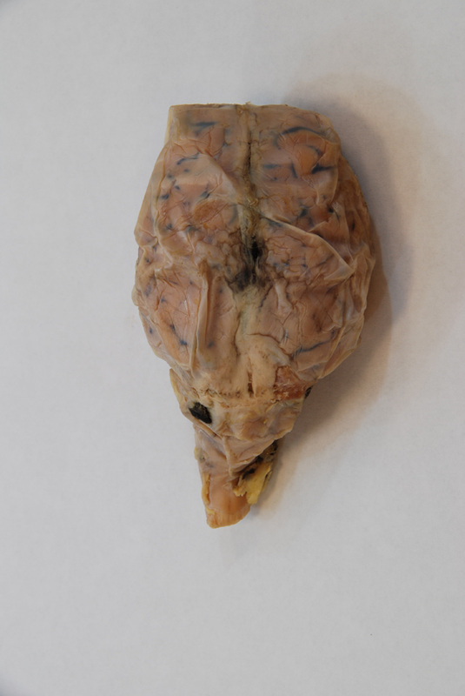
*click to the next slide to check your answer

Slide 4
Dura mater

Slide 5
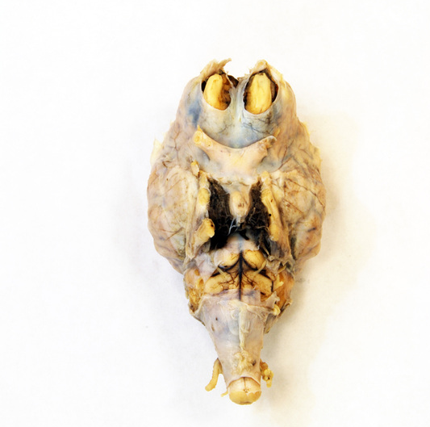
*click to the next slide to check your answer

Slide 6
Pituitary gland

Slide 7
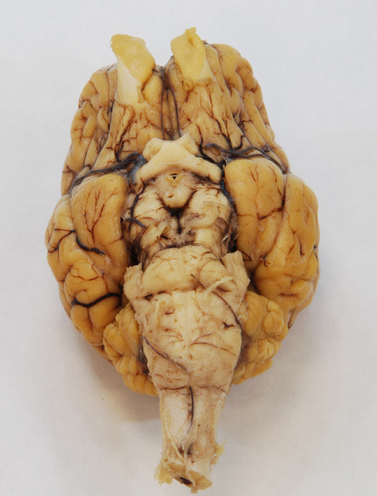
*click to the next slide to check your answer

Slide 8
Olfactory bulb

Slide 9
*click to the next slide to check your answer

Slide 10
Trigeminal nerve (CN V)

Slide 11
*click to the next slide to check your answer

Slide 12
Mamillary body

Slide 13
*click to the next slide to check your answer

Slide 14
Optic tract

Slide 15
*click to the next slide to check your answer

Slide 16
Spinal cord

Slide 17
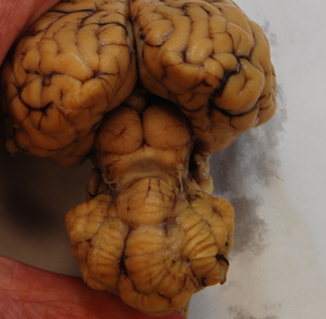
*click to the next slide to check your answer

Slide 18
Longitudinal fissure

Slide 19
*click to the next slide to check your answer

Slide 20
Superior colliculus

Slide 21
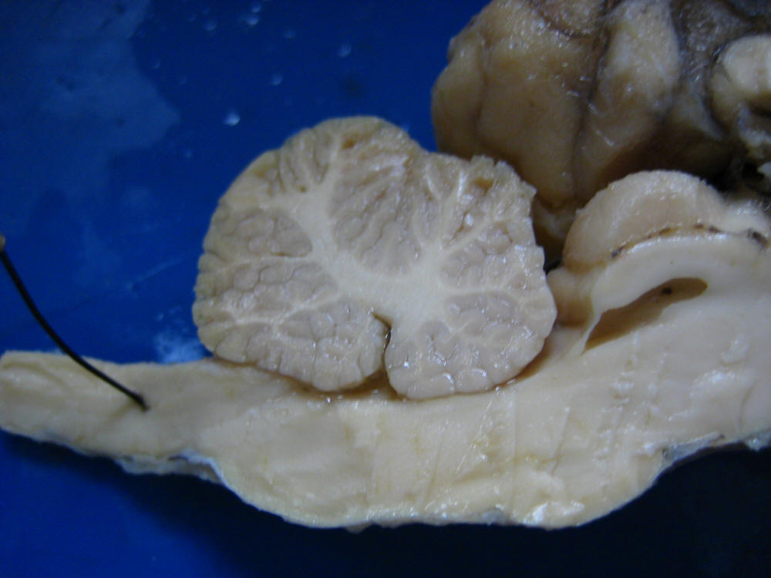
*click to the next slide to check your answer

Slide 22
Inferior colliculus

Slide 23
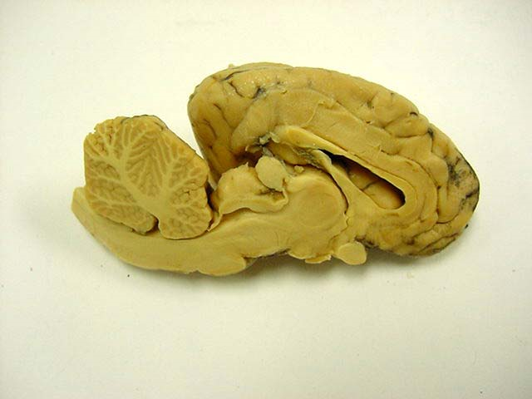
*click to the next slide to check your answer

Slide 24
Thalamus

Slide 25
*click to the next slide to check your answer

Slide 26
Corpus callosum

Slide 27
*click to the next slide to check your answer

Slide 28
Pineal gland

Slide 29
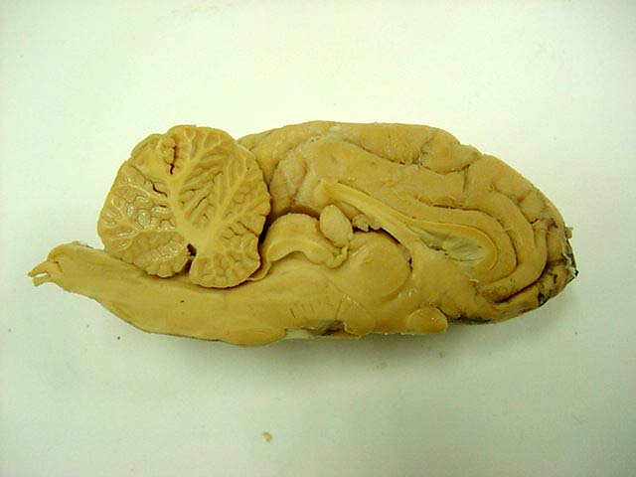
*click to the next slide to check your answer

Slide 30
Arbor vitae of cerebellum

Slide 31
*click to the next slide to check your answer

Slide 32
Hypothalamus

Slide 33
*click to the next slide to check your answer

Slide 34
Corpus callosum

Slide 35
*click to the next slide to check your answer

Slide 36
Septum pellucidum

Slide 37
*click to the next slide to check your answer

Slide 38
Pons

